Slide 1

@HumanomicsMap
Responsible and responsive university impact assessment
David Budtz Pedersen PhD
Professor of Impact Studies & Science Communication
Aalborg University Copenhagen
28 November 2019
AESIS Winter Course on Societal Impact | Oslo

Slide 2




Professor, Aalborg University
Director of Humanomics Research Centre
AAU Department of Communication & Psychology
Mapping the Dynamics and Public Value of Humanities 2012-2020
Responsible Impact (ReACT) 2016-2020
Open Research Analytics (OPERA) 2017-2019
ACCOMPLISSH H2020 EU 2016-2019
Danish Government’s Commission on Rewards in Research
Danish Government’s Expert Group on Open Science
David Budtz Pedersen

Slide 3











Slide 4

Agenda of the presentation
The four I-s of Research Impact
INVESTING IN IMPACT. Alignment of mission statement (strategy/values) impact profile and indicators.
INCENTIVES. Without emphasis on incentives, recognition, and impact awards, most research impact activities will not occur.
INSTRUMENTS. Build inter- and transdisciplinary teams with a challenge-driven, mission-oriented, partnership approach to research
INDICATORS. Better, more robust data about impact activities
used to learn from best practices and inform new strategies

Slide 5
European universities’ impact agenda
Universities and research units are expected to establish an ex post record for impact (for careers, funding, accountability etc.)
In several countries, societal impact becomes obligatory component of research (EU, SIAMPI, IMPACT-EVT, REF, NSF, SEP etc.)
University management often lacks strategic data about impact activities / third mission / social / cultural / regional impact
Nordic model of impact: No uniform model or national framework, myriad of initiatives & indicators, TTO, rewards, incubators, etc.

Slide 6
1. Investments

Slide 7




The Institutional Challenge
Partnership
RESEARCH
INSTITUTIONAL Change
CAPACITY
Build a sustained institutional partnership with a public agency or nonprofit organization
Pursue a joint research agenda to reduce inequality in youth outcomes
Create institutional change to value research-practice partnerships and their work
Develop the partners’ capacity to collaborate, and to produce and use high-quality relevant research + knowledge exchange capacity
Notes:
The Institutional Challenge grant was designed to address these barriers. The grant encourages:
research institutions to build sustained research-practice partnerships with public agencies or nonprofit organizations;
to have the partnerships pursue a joint research agenda to reduce inequality in youth outcomes.
To create institutional change to value research practice partnerships and their work.
And to develop Both partners’ capacity to collaborate, and to produce and use high-quality, relevant research
While these challenges are ambitious, we believe this is what is needed to advance the production and use of research in ways that benefit youth.

Slide 8
Impact Investing
Investments "made into companies, organizations, and funds with the intention to generate measurable, beneficial social or environmental impact” alongside and beyond financial return.” (2017 Annual Impact Investor Survey)
Provides resources for researchers to create companies, collaborate or co-create solutions, which fall within the university’s attempt to address societal challenges.
Impact investing can help organizations carry out their projects and initiatives without having to rely heavily on subsidies or venture capital e.g. external funding.

Slide 9
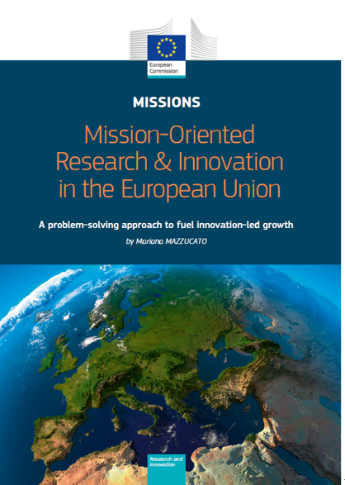
“Missions around societal challenges are more complex than going to the moon and must be open, bottom up, flexible, adaptable and engage with citizens from the beginning”
Mariana Mazzucato 04.03.2018

Slide 10


Slide 11
2. Incentives

Slide 12
Incentives, Rewards and Purpose
Building an impact culture / impact literacy
Getting researchers onboard in entrepreneurial activities incl. support, incubation, acceleration
Strong identity of public good character of knowledge production (e.g. Open Science)
Alignment of research portfolio, reward system and institutional culture

Slide 13
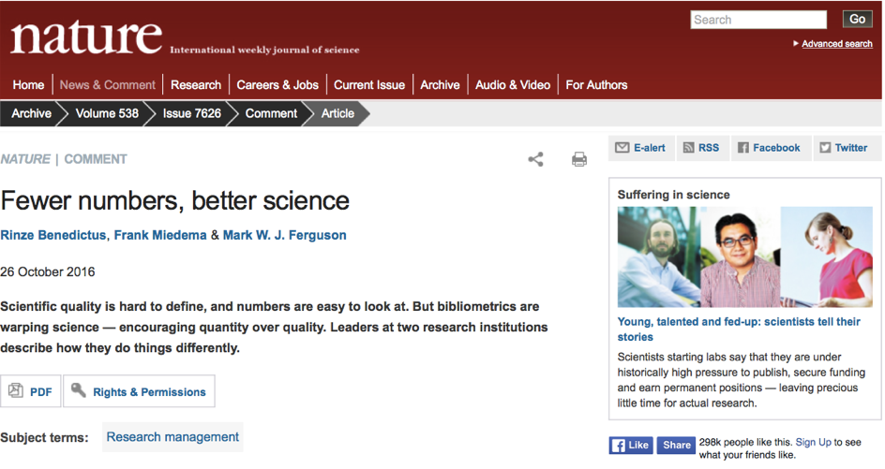
“Publications that directly influence patient care are weighted no higher in evaluations than any other paper, and less if the work appears in the grey literature (official reports rather than in scientific journals). Researchers are actively discouraged from pursuing publications that might improve medicine but would garner few citations. … Publication pressure is keeping scientists from doing what really matters”

Slide 14
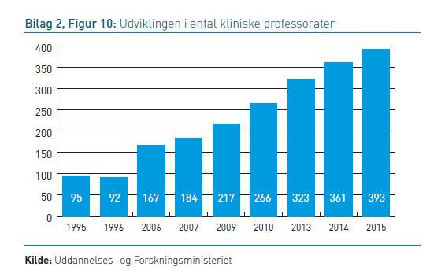
Mobility of researchers
Different ways of producing tangible societal impact
Interactions with society: start-ups, fellowships, special grants, visits, consultancy, joint appointments, co-creation, cost-sharing, collaboration, alliances, research parks etc.
New positions tailor-made for collaborative research: “clinical” professor, knowledge brokers.

Slide 15
Matrix for sector mobility
Full mobility
Shared positions
Longer visits
Part time affiliation
Shorter visits
NAT
HUM
SOC
HEALTH
VET
ENGI
Intensity scale

Slide 18
Instruments for making universities drivers of dual impact

Slide 19



The permeable university

Slide 20
The Discovery Themes provide Ohio State with an unprecedented opportunity to find durable solutions to today’s—and tomorrow’s—most compelling global issues.

Slide 21
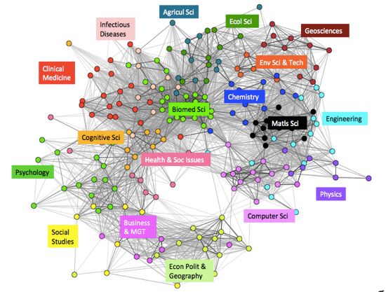
Humanities and social sciences

Slide 22

Indicators

Slide 23
Realizing the impact value chain

Slide 24
ReAct Impact Assessment Platform
Budtz Pedersen et al. (2018). ‘Narratives by Numbers’
PRODUCTS
blogs
e-newsletter/brief
educational material
data analysis
software
fact sheet
handbook
journal article
newspaper article
press release
physical artefacts
reports
research testimony
video, audio, film
product development
EVENTS
annual meeting
awards ceremony
conference
debate
forum
interactive workshop
guest lecturing
media event (e.g. TV or radio segment)
panel / debates
presentation
symposium
policy advice
NETWORKS
policy network
community of practice
discussion board
listserv
online forum
social media
media contacts
Incubators
partner pitch
Notes:
Procedural benefits

Slide 25

EX ANTE
EX POST
e.g.
Impact Planning
Match-making & partner search
Shared definitions of research problem
Clarify expectations
Incentives & rewards
Direct observable impacts
Media / public awareness
Socio-economic benefits
New research questions
Behavioural / institutional change
e.g.
Change in policy
New practices
Contracts, grant applications, impact strategies, technology transfer agreements etc.
Changes in policy, organisation, business, practice etc. described in collaboration with non-academic partners
Resources, inputs and planning
Research and engagement
Outputs
Outcomes
Impact

Slide 26
EX ANTE
RESEARCH BENEFITS
INTERACTIONS
IMPLEMENTATION
EX POST
e.g.
Impact Planning
Match-making & partner search
Shared definitions of research problem
Clarify expectations
Incentives & rewards
e.g.
Co-production of new knowledge
Deeper partnerships
New methods
New tools
New research questions
e.g.
Publications
Conferences and seminars with stakeholders
Social media
Media & public awareness
Artefacts & exhibits
IP including patents
e.g.
Contextualizing results
Best practices established
Practical recommendations
Networks and relationships
Science & Policy Advise
Direct observable impacts
Media / public awareness
Socio-economic benefits
New research questions
Behavioural / institutional change
e.g.
Change in policy
New practices
Contracts, grant applications, impact strategies, technology transfer agreements etc.
Openness, accessibility, increased knowledge base, sharing findings,
Dissemination of outputs through scholarly & non-scholarly channels
Benefits for stakeholders, enhanced Impact Readiness, contributions to practice
Changes in policy, organisation, business, practice etc. described in collaboration with non-academic partners
Resources, inputs and planning
Research and engagement
Outputs
Outcomes
Impact

Slide 27
EX POST
RESEARCH BENEFITS
INTERACTIONS
IMPLEMENTATION
EX POST
e.g.
Impact Planning
Match-making & partner search
Shared definitions of research problem
Clarify expectations
Incentives & rewards
e.g.
Co-production of new knowledge
Deeper partnerships
New methods
New tools
New research questions
e.g.
Publications
Conferences and seminars with stakeholders
Social media
Media & public awareness
Artefacts & exhibits
IP including patents
e.g.
Contextualizing results
Best practices established
Practical recommendations
Networks and relationships
Science & Policy Advise
Direct observable impacts
Media / public awareness
Socio-economic benefits
New research questions
Behavioural / institutional change
e.g.
Change in policy
New practices
Academic institution
Contracts, grant applications, impact strategies, technology transfer agreements etc.
Openness, accessibility, increased knowledge base, sharing findings,
Dissemination of outputs through scholarly & non-scholarly channels
Benefits for stakeholders, enhanced Impact Readiness, contributions to practice
Changes in policy, organisation, business, practice etc. described in collaboration with non-academic partners
Stakeholder partnerships
Resources, inputs and planning
Research and engagement
Outputs
Outcomes
Impact

Slide 28
Amo, C. 2007. Conceptualizing research impact: the case of education research. The Canadian Journal of Program Evaluation 22(1):75-98

Slide 29
Responsible & Open Impact Indicators (ReACT)
Aalborg University, Department of Communication and Psychology, 2017-2020
Create a conducive institutional environment, e.g. re-engineering the academic reward system, funding, infrastructure and culture.
When designing indicators, a one-size-fits-all solution is unlikely to work (high domain-specificity across disciplines).
Open Science offers multiple data sources for tracking impact – but should be complemented with case studies and narratives.

Slide 30
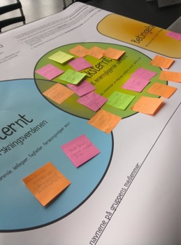
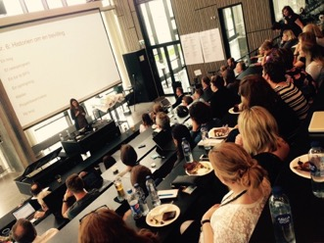
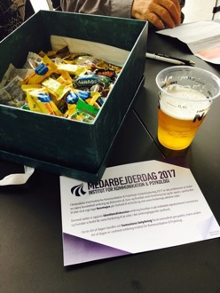
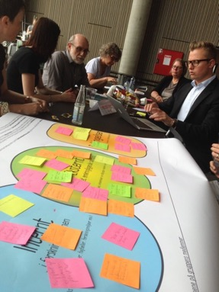
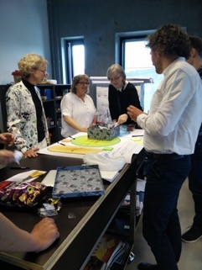
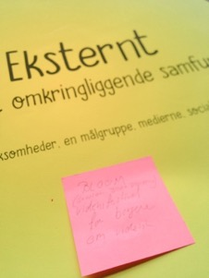

Slide 31
MENTION
RESPONSE
ACADEMIC EVENTS
REQUEST
MEDIA
$$
NON-
ACADEMIC EVENTS
AESTHETIC
INTERACTIVE STUDIES
ACADEMIC
ORG.
ENGAGEM.
POLICY
COMMERCIAL
TEACHING
ACTIVITY
QUALITY ASSESSMENT
MEDIA

Slide 32

COMPREHENSIVE
IMPACT TAXONOMY
CATEGORIES MOST DIRECTLY RELATED TO POLICY INFLUENCE
MEMBER
CHAIR
ADVISORY BOARD
WORKING GROUP
INVITED EXPERT
SCIENCE
INFORMAL
POLICY OUTLETS
ETHICAL
GREY LIT
COMMUNICATION
GREEN PAPERS
ADVICE
POLICY
WHITE PAPERS
STRATEGIC
POLICY DOCS
PERSONAL
LAW TEXTS

Slide 33
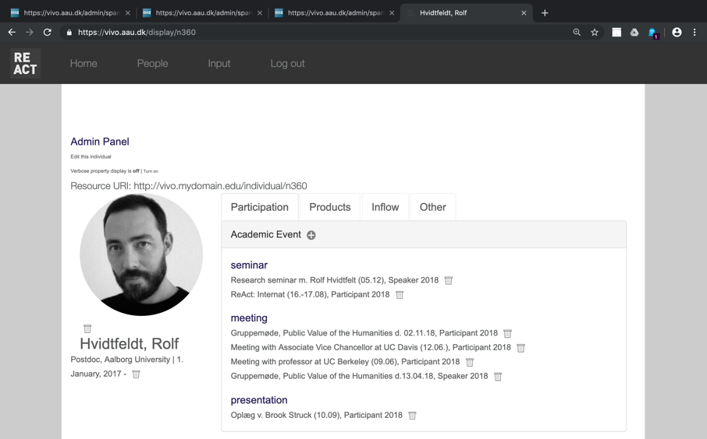
ViVO ReACT Impact Platform

Slide 34
Conclusions
We need healthy, connected institutions
Create infrastructures and incentives to enable knowledge exchange
Build your impact strategy from mapping key institutional contributions, audiences, stakeholders and values ✅
Align university mission/strategy with impact indicators, skills, incentives, co-design metrics with staff and stakeholders (‘theory of change’)
Notes:
Actions and characteristics of special users
What the people do with the system more important than what the train allows (from A to B). Think about the social journeys that takes place rather than the train rides.

Slide 35
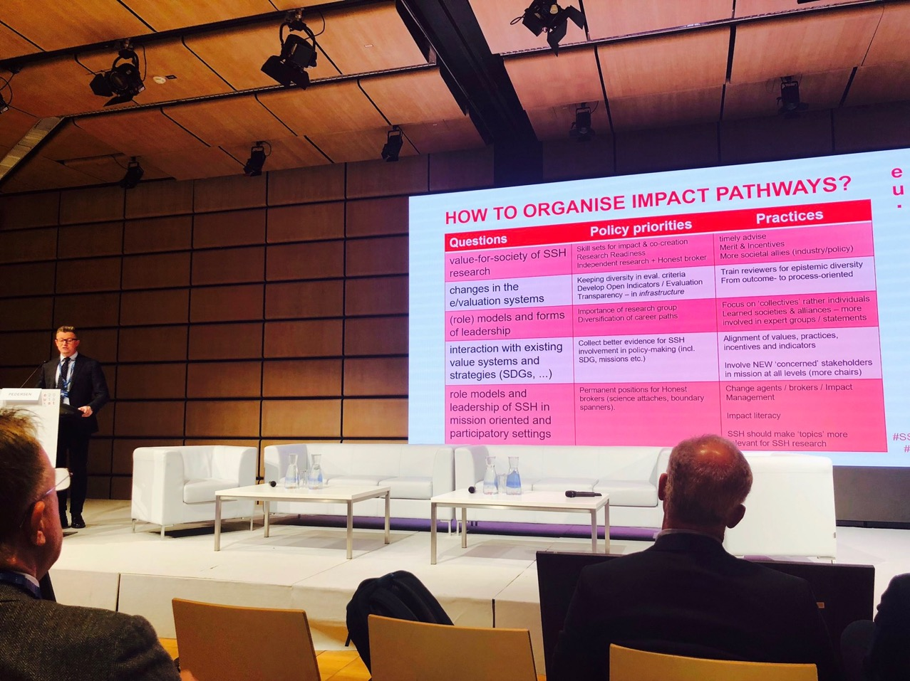

Slide 36
Thank you for the attention
David Budtz Pedersen: davidp@hum.aau.dk
Twitter: @HumanomicsMap
Website: http://mapping-humanities.dk
Contributions from Rolf Hvidtfeldt & Jonas Grønvad

